Slide 1
Workshop 6: Robot arm Forward Kinematics
Crash Course to robot arm control

Slide 2
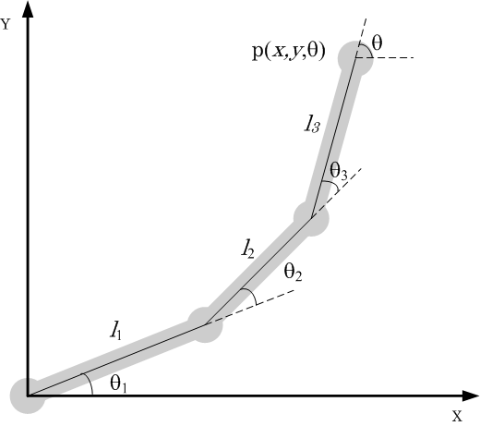

What’s Kinematics?
It’s the mechanics of understanding how an object moves in space with no consideration of force or mass.
In our workshops, we'll use kinematics to figure out how to control Robot arms to move the gripper to a (X-Y-Z) point or follow some trajectory. This has lots of applications and makes it better when we want to use sensors on the arm.
That is we want to control in a cartesian task space instead of joint space
The workshops will walk through this aspect until
How does the tool point x-y-theta value change with robot joints $θ_{1}$, $θ_{2}$, $θ_{3}$?

Slide 3
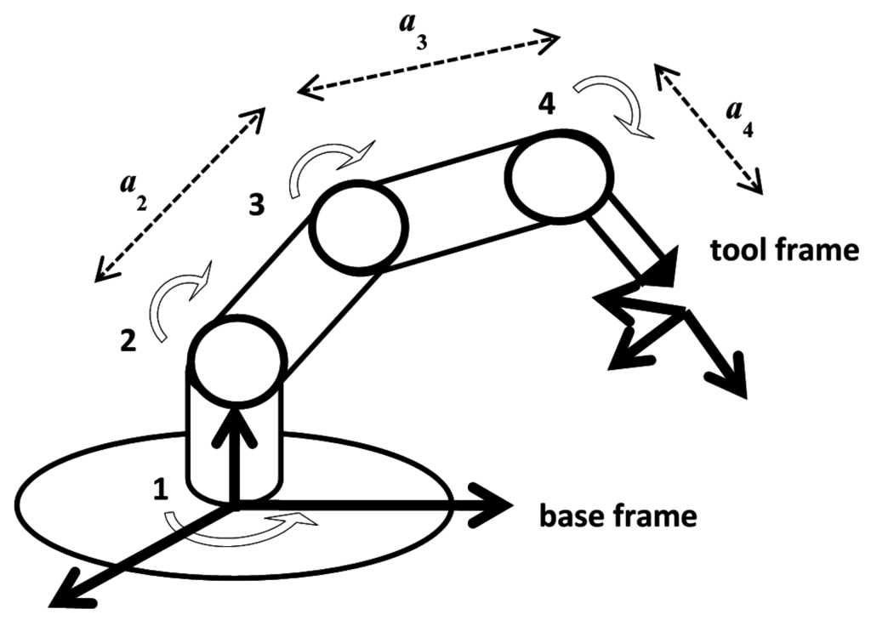
What's Forward kinematics?
Forward Kinematics is finding “Where is the tool point?”
We solve it by reading the joints and doing (getting the PI to do) the math to solve the X Y Z location of the Gripper.
If you’re good at math, you could solve this with trigonometry but it is probably better to use the standard techniques in Introduction to Robotics as it looks it through coordinate frames

Slide 4
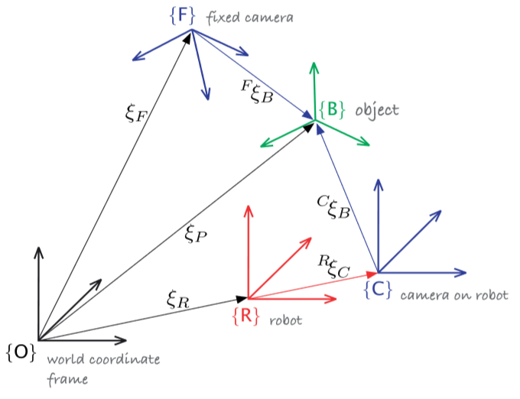
3D Coordinate Frames in Robotics
In robotics engineering, we use coordinate frames to define where objects are in 3D space.
Each object of interest can have a coordinate frame or at least an XYZ point. Usually your interested in where the sensor is, where it detected something, the robot base or where some target is on a map…
To know where each object is in relation to each other, we use a TRANSFORM to go from one coordinate frame to another…
A specific transform is referred to as a pose

Slide 5
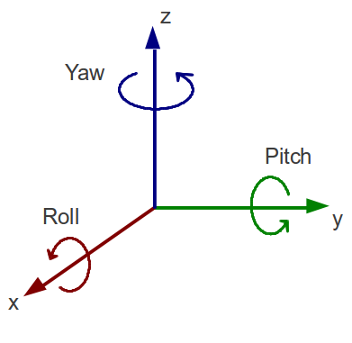
3D transformation
Any transform in space consists of a displacement and rotation part
3D space has what’s called 6 degrees of freedom:
Displacement in the X, Y and Z directions
Rotation about the X-axis, Y-axis, Z-axis that is roll, pitch and yaw

Slide 6
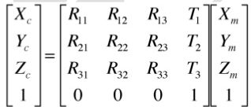
3D transformation Matrix
A rotation and translation from one from to another is represented mathematically as a Matrix:
The matrix multiplication transforms a point in frame M to frame C:
R11 to R33 are rotation matrix elements and T1, T2, T3 are the X, Y, Z displacements of the transformation
The symbol for the transform matrix is generally T

Slide 7
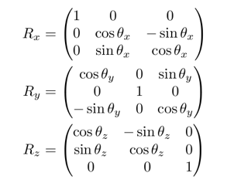
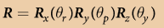
3D Rotation Matrix
In the Transform, there consists a rotation matrix that is 3 by 3 for 3D
Roll, Pitch, Yaw angle rotations form matrices like these:
Rx rotates a frame about the x axis by theta-x
Ry rotates a frame about the y axis by theta-y
Rz rotates a frame about the z axis by theta-z
Doing the Matrix multiplication combines them together

Slide 8
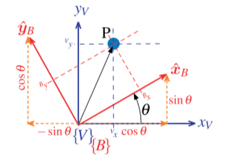
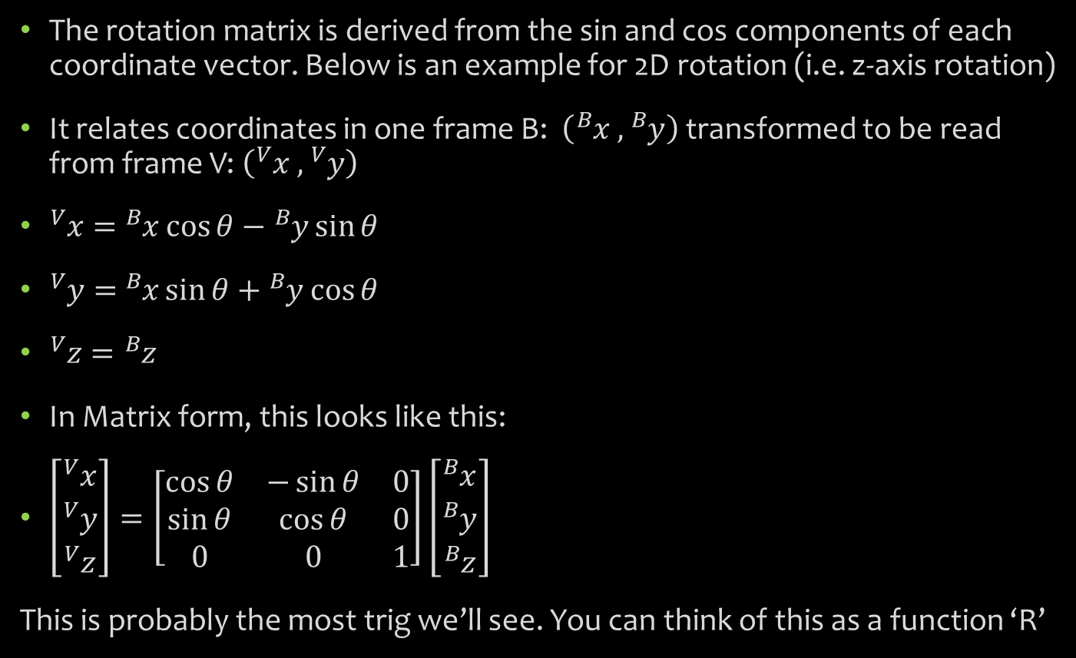
How a rotation matrix works:
The rotation matrix is derived from the sin and cos components of each coordinate vector. Below is an example for 2D rotation (i.e. z-axis rotation)
It relates coordinates in one frame B: $\left({}_{ }^{B}x ,{}_{ }^{B}y\right)$transformed to be read from frame V: $\left({}_{ }^{V}x ,{}_{ }^{V}y\right)$
${}_{ }^{V}x=$ ${}_{ }^{B}x\cos{θ}−{}_{ }^{B}y\sin{θ}$
${}_{ }^{V}y=$ ${}_{ }^{B}x\sin{θ}+{}_{ }^{B}y\cos{θ}$
${}_{ }^{V}z={}_{ }^{B}z$
In Matrix form, this looks like this:
$\left[\begin{matrix}{}_{ }^{V}x \\ {}_{ }^{V}y \\ {}_{ }^{V}z\end{matrix}\right]=\left[\begin{matrix}\cos{θ} & −\sin{θ} & 0 \\ \sin{θ} & \cos{θ} & 0 \\ 0 & 0 & 1\end{matrix}\right]\left[\begin{matrix}{}_{ }^{B}x \\ {}_{ }^{B}y \\ {}_{ }^{B}z\end{matrix}\right]$
This is probably the most trig we’ll see. You can think of this as a function ‘R’

Slide 9
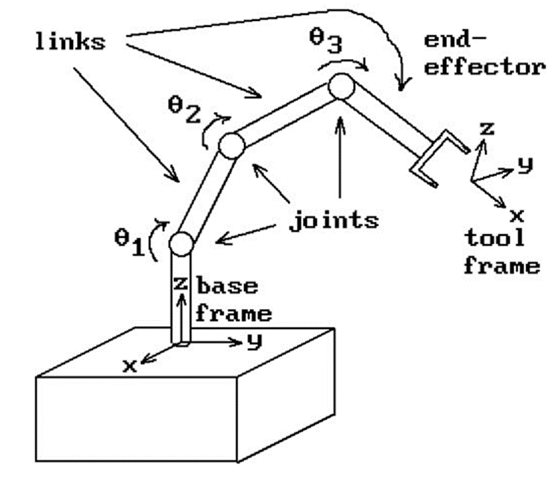
How to use the Matrix…
Back to the problem, we need to know where the gripper is to control its position.
So the technique is to put coordinate frames and find the translation and rotation parts between each joint. That involves finding the 6 values for X, Y, Z, roll, pitch, yaw
We then will do matrix multiplication to find the overall X Y Z displacement:
But there is another simplification to all of this…

Slide 10
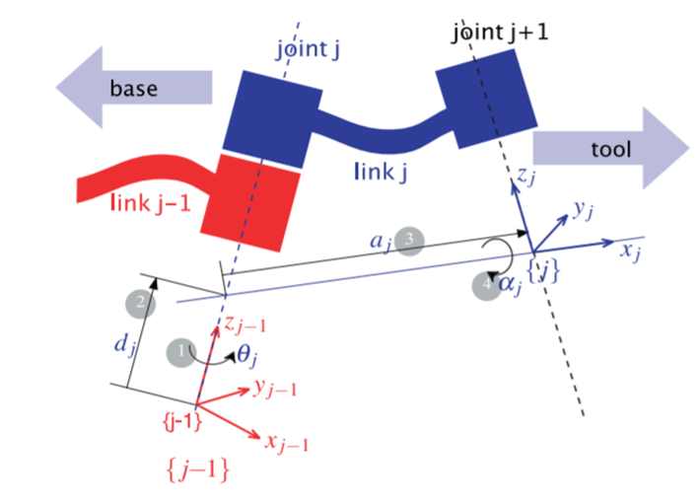
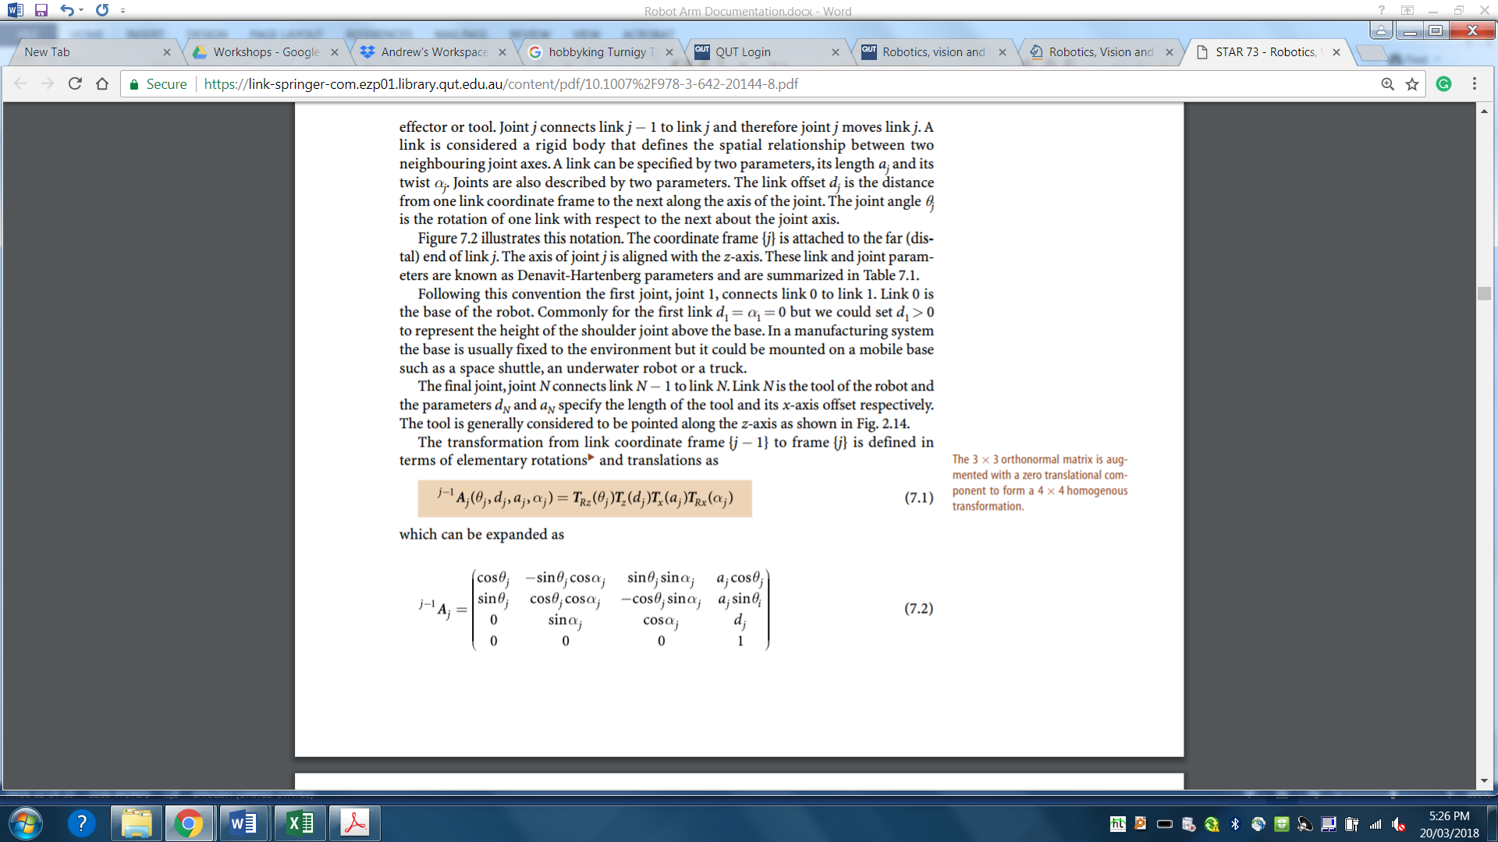
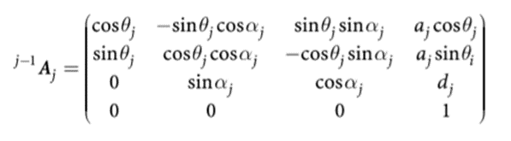
DH Parameters
In mechanical links (like the ones in a robot arm) each joint only rotates about one axis and its possible to simplify the matrix…
Denavit-Hartenburg figured out that if you put the frames so that the z-axis is the axis of joint rotation… its possible to eliminate the need for the Y axis components
There are only 4 values then which are referred to as theta (Rz), d (tz), a (tx), and alpha (Rx)
This leads to a standard transform matrix to be used for all joints. Now this, is a function we’ll just use 4 times to skip lots of trig and find the forward kinematics…

Slide 11
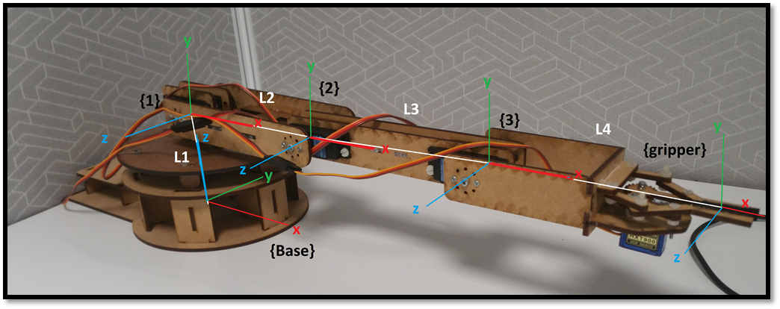
How do we use the theory…
STEP 1: put coordinate frames on each joint. Start with the base frame z-axis in line with axis of rotation. Put the x-axis to know where the 0 degree rotation is. Try to make link lengths L1 or L2 go only on the z or x axes…
STEP 2: Find the DH parameters Rx, X, Rz, Z values for each transform

Slide 12
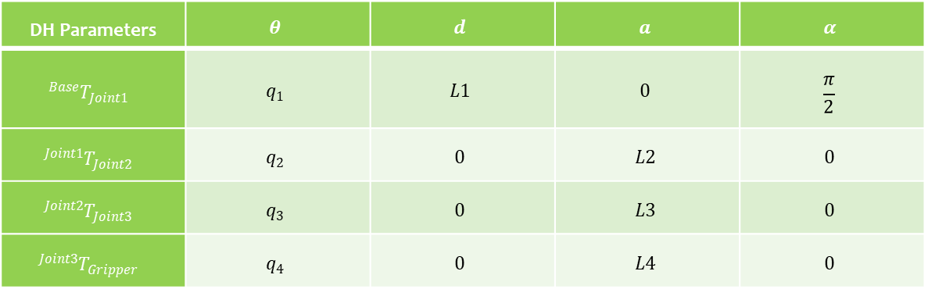
Solving the DH parameters:
For finding the theta values is easy. Rz rotation is always the variable rotation of the joint q
Hard part: The base frame displaced to the next frame by L1 in the z direction and the z-axis moved around the x-axis by 90 degrees so alpha is pi on 2
After that each joint repetitively translates along the x-axes by the link lengths L2,L3 and L4 NOTE. L1 = 100mm, L2 = 120mm, L3 = 140mm, L4 = 140mm
You may have realised that there are other ways of going about this but this version of the solution is nicer by having more zeros in the DH parameters
DH Parameters | $$θ$$ | $$d$$ | $$a$$ | $$α$$
$${}_{ }^{Base}{T_{Joint1}}$$ | $$q_{1}$$ | $$L1$$ | $$0$$ | $$\frac{π}{2}$$
$${}_{ }^{Joint1}{T_{Joint2}}$$ | $$q_{2}$$ | $$0$$ | $$L2$$ | $$0$$
$${}_{ }^{Joint2}{T_{Joint3}}$$ | $$q_{3}$$ | $$0$$ | $$L3$$ | $$0$$
$${}_{ }^{Joint3}{T_{Gripper}}$$ | $$q_{4}$$ | $$0$$ | $$L4$$ | $$0$$

Slide 13
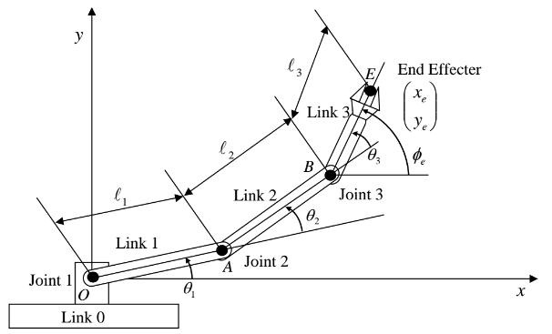
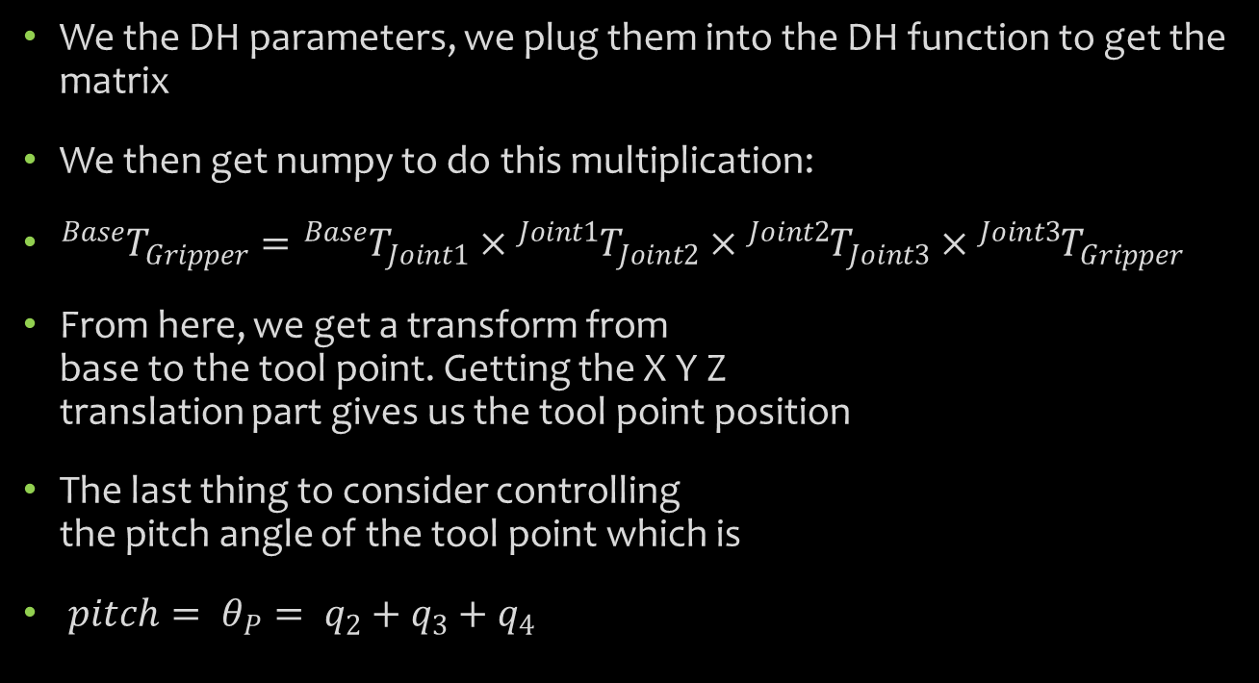
Using the Transforms…
We the DH parameters, we plug them into the DH function to get the matrix
We then get numpy to do this multiplication:
${}_{ }^{Base}{T_{Gripper}}={}_{ }^{Base}{T_{Joint1}}×{}_{ }^{Joint1}{T_{Joint2}}×{}_{ }^{Joint2}{T_{Joint3}}×{}_{ }^{Joint3}{T_{Gripper}}$
From here, we get a transform from base to the tool point. Getting the X Y Z translation part gives us the tool point position
The last thing to consider controlling the pitch angle of the tool point which is
$pitch= θ_{P}= q_{2}+q_{3}+q_{4}$

Slide 14
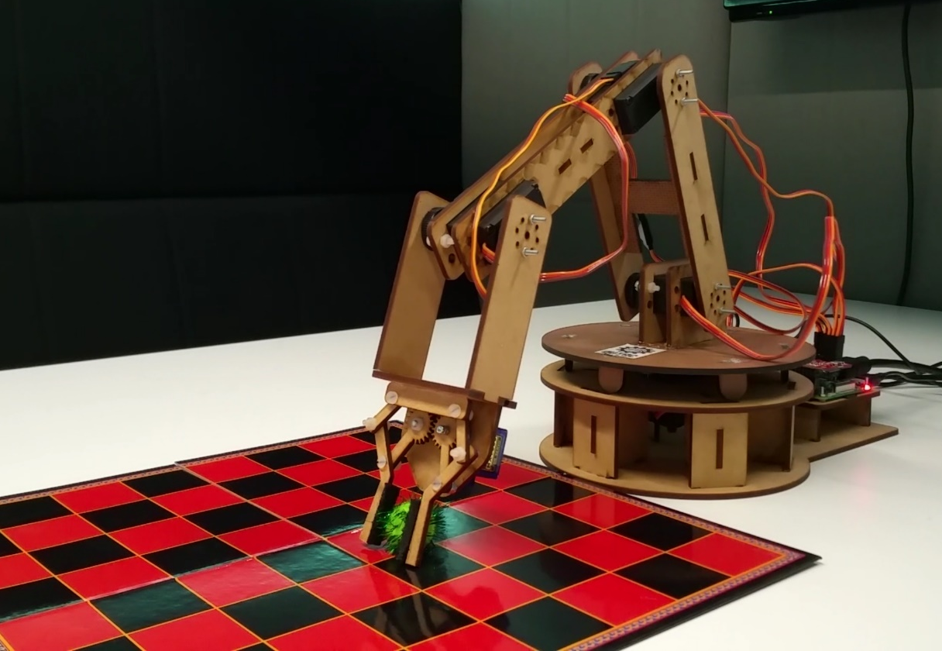
Conclusion
Overall, forward kinematics has laborious theory for something that is really just using the same matrix function four times to skip a head ache of geometry
We now know given some joint inputs, where the gripper position is.
The next step is to do this backwards. Tell the robot to find its own joint limits to go to a gripper position aka. The Inverse kinematics problem…

